Slide 1

The Era of “Traders”:
How the new-gen is generating an Income?
Devashish harnaran
Notes:
1

Slide 2


THE NEED…
Economic Impact: COVID-19 led to inflation and unemployment, prompting new policies to stimulate economies.
Side Hustles on the Rise: Virtual asset trading, especially among the youth, became a popular "side hustle" amid economic challenges.
Tech in Trading: Traders use technical analysis and trading bots—AI-driven software—for automatic trade execution.
Bot Benefits: Trading bots offer quick and emotionless execution, making financial markets more accessible.
Bot Risks: Reliance on historical data and cybersecurity threats pose risks to trading bot users.
Decision and Risk Management: Users must weigh potential benefits against risks, considering lower capital risks and thorough research before deploying trading bots.
3
Notes:
3

Slide 3
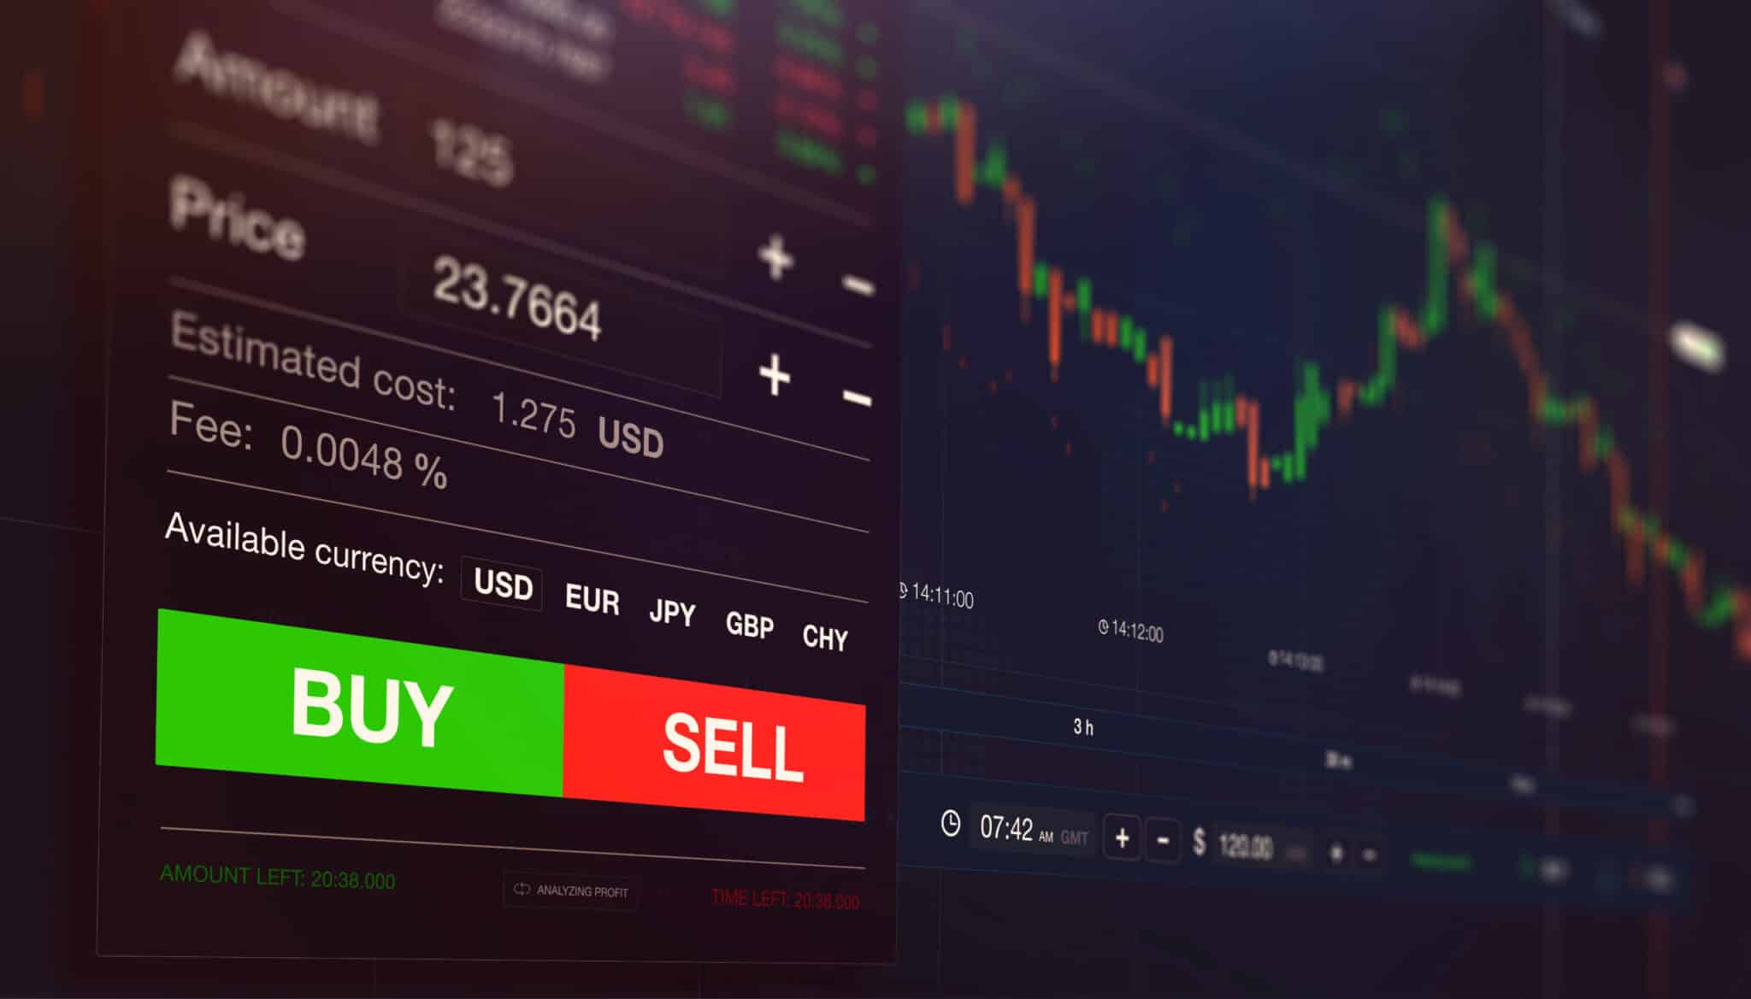
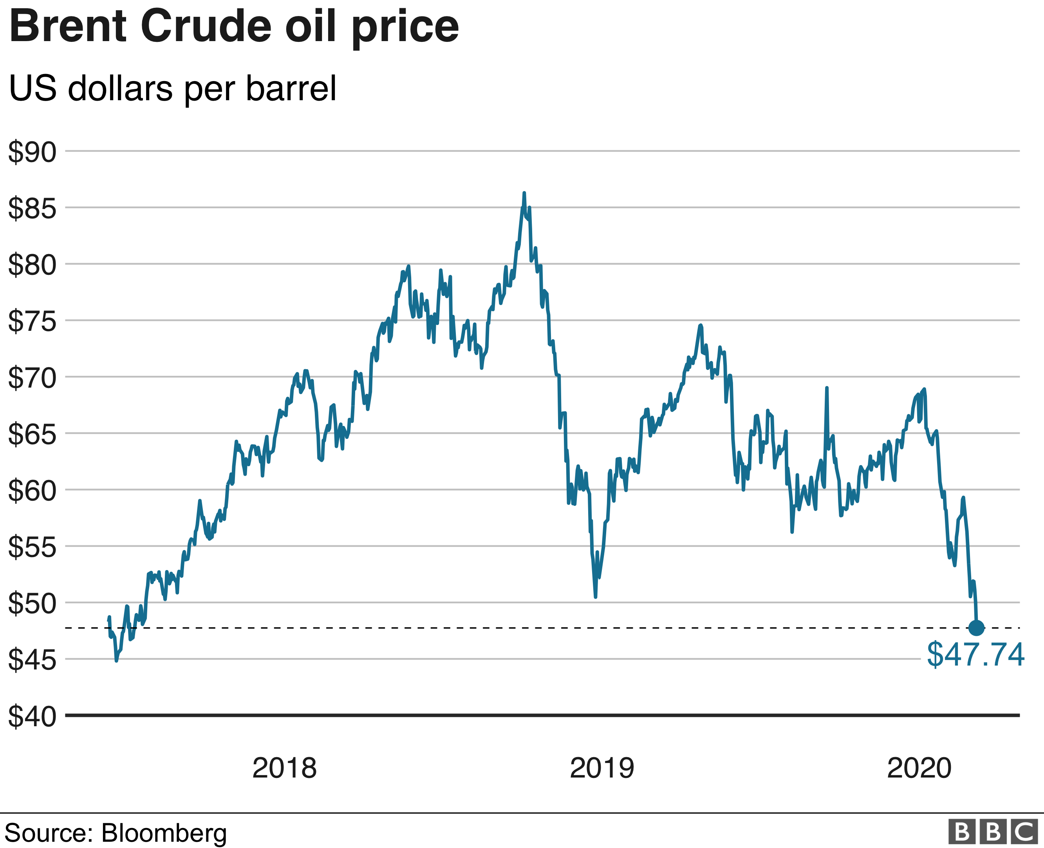
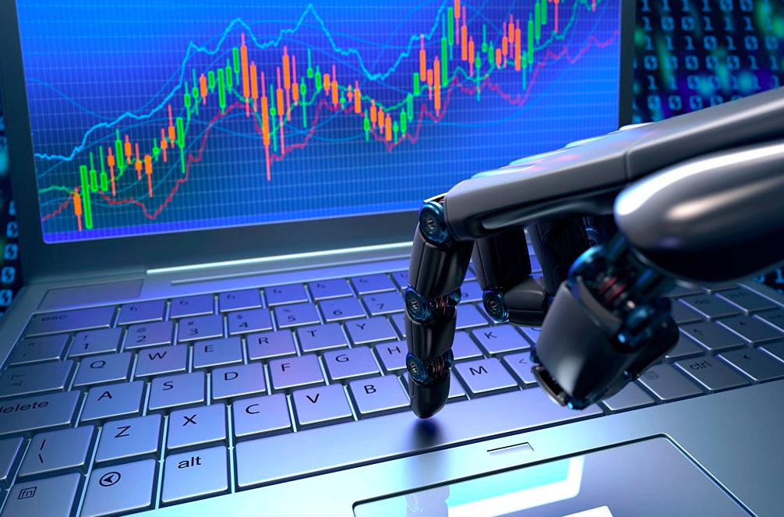
Trading & Ai-Trading
Trader Approaches: Participants, known as 'traders,' analyse markets either fundamentally (economic data) or technically (price movements).
Technical Analysis for Active Traders: Active traders prefer technical analysis for short-term security trading, offering potential rewards with associated risks.
CFA Institute Principles: CFA Institute highlights technical analysis principles, emphasizing market discounting, trend movements, and repetitive price patterns.
Modern Tools Integration: Institutions adopt modern tools, including Artificial Intelligence, to enhance trading strategies based on technical analysis.
Trading Bots: These automated programs leverage AI for market analysis and execute virtual asset trades with predefined algorithms.
‹#›

Slide 4

disadvantages
Advantages
Swift Execution in Volatility: Trading bots allow quick trades, vital in volatile markets like cryptocurrencies, operating at impressive speeds.
Emotion-Free Efficiency: Bots lack emotions, ensuring a rational approach by avoiding emotional biases during speculation.
Freedom for Stakeholders: Money works for individuals with trading bots, offering financial and geographical freedom.
Accessible to All: User-friendly interfaces and automation make virtual asset trading accessible to those without formal finance backgrounds.
No Need for Finance Degrees: Unlike traditional markets, virtual asset trading doesn't require a formal finance degree, broadening participation.
Diverse Investment Opportunities: Trading bots simplify market participation, opening doors for a wide range of people to explore and profit from diverse investment opportunities.
Algorithm Reliance: Trading bots use historical data for algorithms, but this may not suit present market conditions, especially during major events like Federal Reserve meetings.
Future Unpredictability: Past success doesn't guarantee future outcomes, emphasizing the inherent uncertainty in financial markets.
Technical Disruption Risks: Traders using bots need a stable setup; any disruption can halt trading, leading to missed profits or potential capital loss.
Cybersecurity Threats: Virtual asset trading and bot use increase the risk of security lapses and cyberattacks due to the shift to digital platforms.
Target for Malicious Actors: Unsecured bots attract hackers, posing risks of fraud and compromise of trading account security.
Security Priority: Traders must prioritize cybersecurity measures, including two-factor authentication and regular software upgrades, to protect money and data.
‹#›

Slide 5

Conclusion
Personal Choice: The decision to use trading bots is subjective and depends on individual goals in the financial market.
Passive Income Potential: Trading bots offer the potential for generating passive income, providing financial freedom.
Risk Mitigation: To address potential downturns, individuals can manage risks by risking a lower percentage of capital.
Informed Decision-Making: Thorough research and demo account testing before deploying real money are essential for making informed decisions about using trading bots.
5

